Slide 1
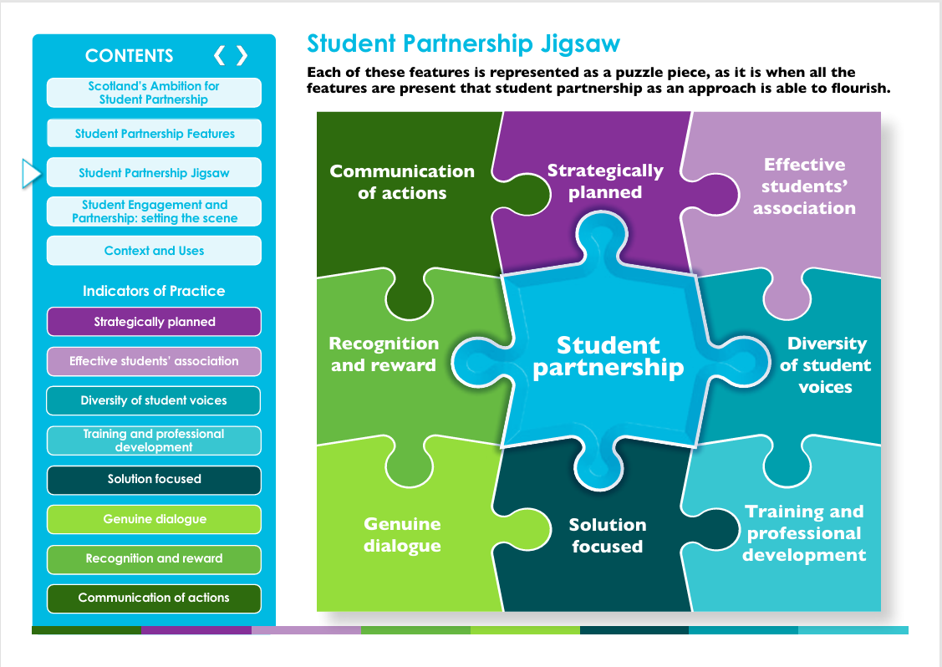
Scotland’s Ambition for Student Partnership
‘Diamond 9’ Activity Pack

Slide 2
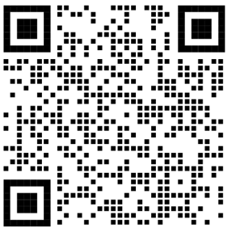
Accessing Core Resource
Hyperlink: Scotland’s Ambition for Student Partnership
QR code:

Slide 3
Student Partnership Jigsaw

Slide 4
Overview
Diamond 9 activities can be used to prompt ranking and discussion within small groups.
Activities are based around arranging 9 cards into a ‘Diamond 9’ shape with:
Most important at top.
Least important at bottom.
Can be used for variety of purposes, for example:
Identifying priorities for future enhancement.
Celebrating examples of good practice.
Identifying and unpacking differences between staff and students (see slide 6 for example).
1
Most important
2
3
4
5
6
7
8
9
Least important

Slide 5
Instructions: Diamond 9 activity
Work in small groups.
Nominate the following roles and tasks:
Timekeeper: keep group to time.
Scribe: write down key discussion points.
Spokesperson: feed back verbally to wider group.
Ensure that everyone’s voice is heard.
Discuss, rank and arrange your 9 cards into the ‘Diamond 9’ shape shown.
The blank card is intentional – your group can add your own category to this if desired.
1
Most important
2
3
4
5
6
7
8
9
Least important

Slide 6
One example activity: Part 1
Purpose: To identify, compare, and discuss student and staff opinions around student partnership initiatives at your institution
Plenary:
Outline the overall purpose of the session.
Explain instructions for undertaking a Diamond 9 activity.
Round 1:
Divide into small groups (3-4) of either students or staff.
Complete Diamond 9 activity.
Record this on a Diamond 9 recording sheet.
1
Most important
2
3
4
5
6
7
8
9
Least important
This activity is continued on slide 6

Slide 7
One example activity: Part 2
Round 2:
Ask 1 or 2 members of each group to rotate to another group.
Staff should move to a student group, and vice versa.
Groups should now include a mixture of students and staff.
Repeat the Diamond 9 activity, revising the original Diamond 9 (if appropriate) in response to group discussion.
Record this on a new Diamond 9 recording sheet.
Plenary:
Feed back to wider group: Any changes made to Diamond 9 and key related discussion points.
1
Most important
2
3
4
5
6
7
8
9
Least important

Slide 8
Diamond 9 cards (for ‘on campus’ or ‘online’ activities)

Slide 9
Instructions: Cards for ‘on campus’ activities
Use this PowerPoint file to print off A5 sized cards for Diamond 9 activities:
Load plain card into your printer.
Go to File/Print and then select 2 slides handout (2 slides per page).
Select slides 11-19.
Cut your printouts into individual cards for use within your activities.
1
Most important
2
3
4
5
6
7
8
9
Least important

Slide 10
Instructions: Cards for ‘online’ activities
Use this PowerPoint file to save electronic versions of the cards for your online Diamond 9 activities:
Go to File/Save a Copy.
Select jpg format.
Select ‘just this one’ for slides 11-19 of this PowerPoint file.
This will create 9 individual jpg image files (one for each Partnership Features jigsaw piece + a Blank Card).
Upload these 9 images to an electronic white board (e.g. Padlet) which will allow colleagues to sort them into a Diamond 9 formation.
1
Most important
2
3
4
5
6
7
8
9
Least important

Slide 11
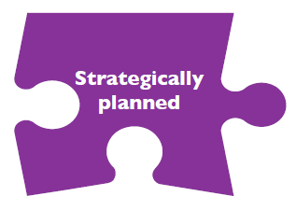
Strategically planned
Partnership is strategically planned, resourced, evaluated and enhanced at all levels of the institution. It is led by student officers and senior institutional managers and jointly owned and widely developed across the institution.

Slide 12

Effective students’ association
Partnership is underpinned by an effective students’ association with a robust, accountable and joined-up representative system, which is able to understand the complexity of the student experience and effectively influence decision making.

Slide 13

Diversity of student voices
Partnership values the diversity of student voices, their backgrounds and their lived experiences. All students who wish to should have the opportunity to participate fully and take on a partnership-level role, and opportunities exist for students to be involved at a level that suits them.

Slide 14

Training and professional development
Partnership requires a range of knowledge and skills, which are acquired through induction, training and professional development, enabling students and staff to carry out a multitude of roles within their student and professional lives.

Slide 15

Solution focused
Partnership is solution focused. Together, students and staff collect, review and interpret evidence; identify priorities; and design solutions that address diverse student needs and meet institutional challenges.

Slide 16

Genuine dialogue
Partnership creates opportunities for genuine dialogue and requires a relationship between the institution, the students’ association and students, which values equally the contribution each brings.

Slide 17

Recognition and reward
Partnership recognises and rewards students for the role that they play in student partnership and for the impact they have made on current and future students.

Slide 18

Communication of actions
Partnership results in actions that are communicated with students in a way which allows them to feel confident that their views are taken seriously and result in change at a local and strategic level.

Slide 19
Blank card
A space to add your own ‘Feature’ of Student Partnership (if you wish):

